Slide 1


30 October 2026
Project Phase-I Review-II
30 October 2026
Paper Title: Enhancing Cloud Data Security Using Paillier Homomorphic Encryption Algorithm
Presented by:
Mr. Mohammed Abdul Kareem (160923753004)
Mr. Mohammed Farhaan Ahmed (160923753038)
Mr. Mohammed Imad Uddin (160923753044)
Under the Guidance of
Mrs. B. Nagalakshmi, Assistant Professor
Department of CS , Lords Institute of Engineering and Technology, (Autonomous), Hyderabad –Telangana -India

Slide 2
OUTLINES
30 October 2026
Introduction
Problem Statement
Literature Review
Research Methodology
Conclusion
References (Base Papers)
Existing System And Disadvantages
Proposed System And Advantages
File Storage & Data Specifications
Expected Input & Output
Department of CS, Lords Institute of Engineering and Technology, (Autonomous), Hyderabad –Telangana -India

Slide 3
30 October 2026
Introduction
Cloud computing offers elastic storage and on-demand computation, but delegating data to third-party providers introduces confidentiality risks.
Standard symmetric encryption protects data at rest but requires decryption into plaintext before any meaningful computation can take place on the server.
This plaintext exposure makes data vulnerable to memory scraping and insider threats.
The Paillier Homomorphic Encryption Algorithm (PHEA) mitigates this by allowing mathematical operations (additive aggregation) to be executed directly on ciphertexts without decrypting them.
Department of CS, Lords Institute of Engineering and Technology, (Autonomous), Hyderabad –Telangana -India

Slide 4
Problem Statement
30 October 2026
Storing sensitive files on third-party cloud servers exposes them to unauthorized server-side compromise.
Traditional storage systems lack multi-tier administrative governance, meaning compromised credentials grant unrestricted access to all stored assets.
Cryptographic keys are commonly controlled by the cloud provider, introducing severe risks of key misuse.
Objective: Develop a Django-based hybrid encryption framework (AES-128-CBC + Paillier) that prevents plaintext exposure, enforces pre-encryption key verification, and requires strict administrator approval for file decryption.
Department of CS, Lords Institute of Engineering and Technology, (Autonomous), Hyderabad –Telangana -India

Slide 5
Literature Review
1. Security-Performance Optimization in Cloud-Based Bank Data Processing Using HE-ZKP-ORAM
Date: 2026 (Engineering, Technology & Applied Science Research)
Drawback: Specific to cloud banking. Combining homomorphic encryption, zero-knowledge proofs and ORAM adds complexity and overhead.
Link: https://etasr.com/index.php/ETASR/article/view/16654
2. Cloud Data Privacy Protection with Homomorphic Algorithm: A Systematic Literature Review
Date: Nov 2025 (Journal of Cloud Computing)
Drawback: A review, so it proposes no system. It covers studies only up to 2024 and focuses mainly on fully homomorphic encryption, not lightweight schemes like Paillier.
Link: https://link.springer.com/article/10.1186/s13677-025-00774-5
3. HHEML: Hybrid Homomorphic Encryption for Privacy-Preserving Machine Learning on Edge
Date: Oct 2025 (arXiv)
Drawback: Built for machine learning inference on edge devices and needs FPGA hardware. It is not a cloud file-storage design.
Link: https://arxiv.org/pdf/2510.20243
4. Pura: An Efficient Privacy-Preserving Solution for Face Recognition
Date: May 2025 (arXiv)
Drawback: Assumes two non-colluding semi-honest servers and a fully trusted organization. Built for face recognition only
Link: https://arxiv.org/pdf/2505.15476
5. Encrypted Vector Similarity Computations Using Partially Homomorphic Encryption: Applications and Performance Analysis
Date: Mar 2025 (arXiv)
Drawback: Focuses on similarity-search performance only. No key management, access control or integrity checks.
Link: https://arxiv.org/abs/2503.05850
30 October 2026
Department of CS, Lords Institute of Engineering and Technology, (Autonomous), Hyderabad –Telangana -India

Slide 6
30 October 2026
Existing System
Old cloud systems protect data while it travels and use simple passwords to log in.
Files are stored as readable text, or the cloud provider controls the secret keys used to lock them.
When the cloud needs to check or process the data, it must unlock the file first, making it readable.
There is no extra approval step from an admin before someone can download and read sensitive files.
Department of CS, Lords Institute of Engineering and Technology, (Autonomous), Hyderabad –Telangana -India

Slide 7
30 October 2026
Disadvantages
Data is Exposed: Because data must be unlocked to be processed, hackers can read it while it is in the cloud's memory.
Server Hacks: If the cloud server is attacked, all user files are completely exposed.
Stolen Passwords: A stolen password gives a hacker full access to everything.
No Admin Control: The admin cannot watch or stop suspicious downloads as they happen.
Department of CS, Lords Institute of Engineering and Technology, (Autonomous), Hyderabad –Telangana -India

Slide 8
30 October 2026
Proposed System
A secure website built with Python and Django that uses a two-part locking method (Hybrid Encryption).
Uses AES-128-CBC to lock large files very quickly.
Uses Paillier Homomorphic Encryption to verify users and do math on locked data.
Users must be approved by the admin (Verified) before they can use the system.
Users cannot just download and unlock files; they must ask the admin for permission first.
Department of CS, Lords Institute of Engineering and Technology, (Autonomous), Hyderabad –Telangana -India

Slide 9
30 October 2026
Advantages
Strong Privacy: Files are locked before they go into the database, so even if the database is hacked, the files remain safe.
Admin Control: Only verified users can log in, keeping bad accounts out.
Pre-Check Security: Users must prove they have the right secret key before the system lets them upload files.
Safe Downloads: Users must request file access, and the admin must approve it and provide the final key.
Fast Processing: Locking a file takes just 19 milliseconds, and unlocking it takes 35 milliseconds.
Department of CS, Lords Institute of Engineering and Technology, (Autonomous), Hyderabad –Telangana -India

Slide 10
File Storage & Data Specifications
30 October 2026
Data Handled: Standard files and numbers.
Locking Method: AES-128 in CBC mode.
Storage Format: Files are saved only as locked binary data.
What the User Sees: The system only shows a short, unreadable preview (hexadecimal); it never shows the real file text.
Database: SQLite (for building) / MySQL (for real use).
Testing Speed: Tested on files of 5,000 bytes to check how fast it locks and unlocks.
Department of CS, Lords Institute of Engineering and Technology, (Autonomous), Hyderabad –Telangana -India

Slide 11
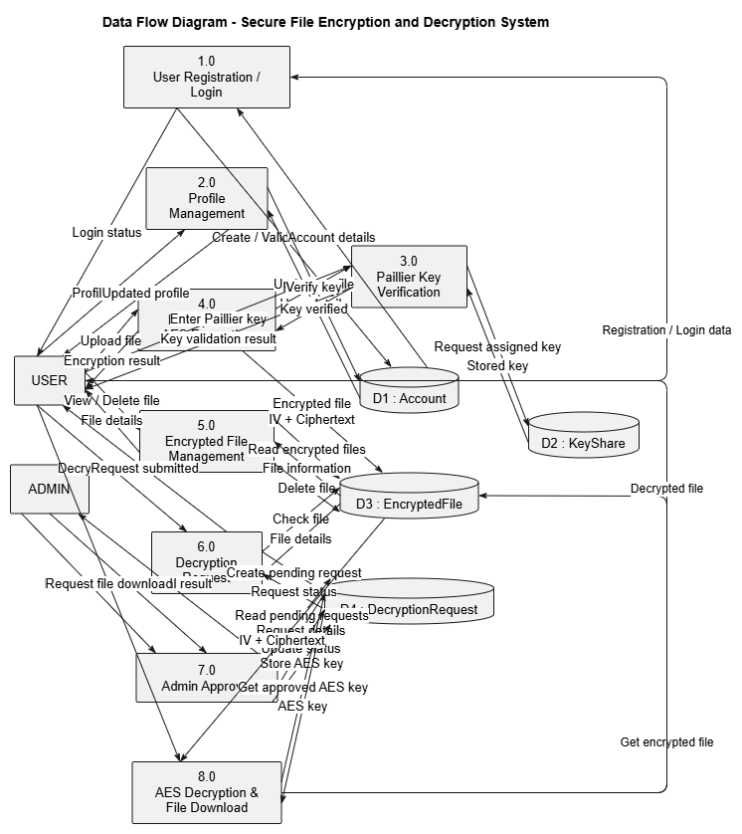
30 October 2026
Methodology / Approach
User Registration & Setup: The Administrator verifies the new account and generates the user's cryptographic keys.
Paillier Key Verification: The user enters their private key. A database match activates an allow_encrypt flag to permit file uploads.
Encrypted File Management: The system locks the uploaded file using AES-128-CBC and safely stores the combined IV and Ciphertext.
Decryption Request: Users cannot unlock files directly; they must submit a download request that is logged as Pending.
Admin Approval: The Administrator reviews the pending request and binds the final AES decryption key to it.
AES Decryption & Download: The system checks the approval, unlocks the file, and provides the restored text to the user.
Fig.1: Data Flow Diagram (DFD) for the Secure File Encryption and Decryption System
Department of CS, Lords Institute of Engineering and Technology, (Autonomous), Hyderabad –Telangana -India

Slide 12
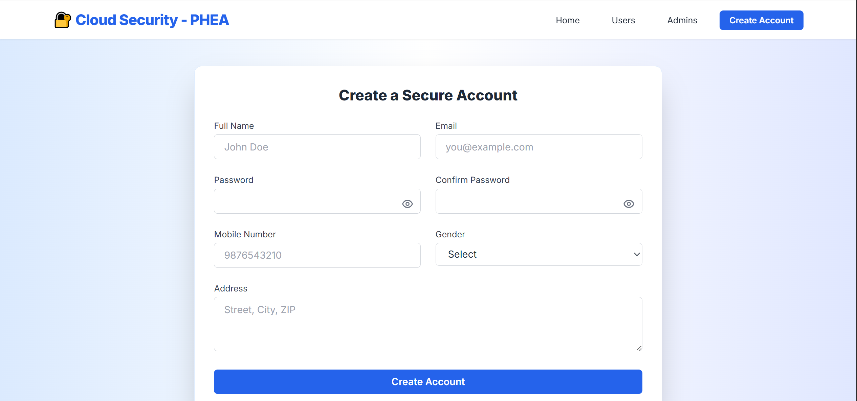
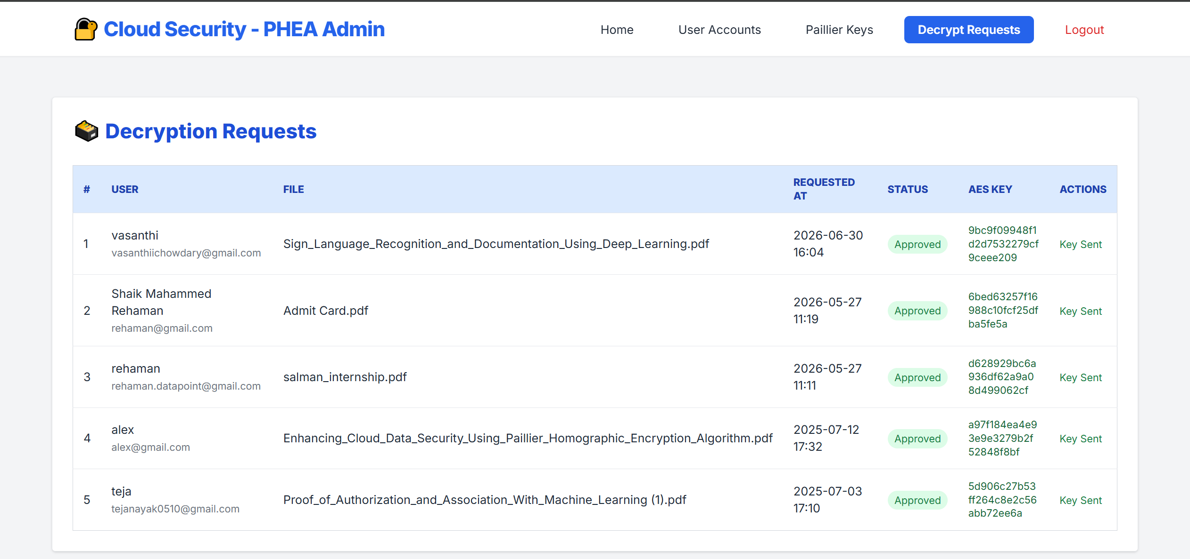
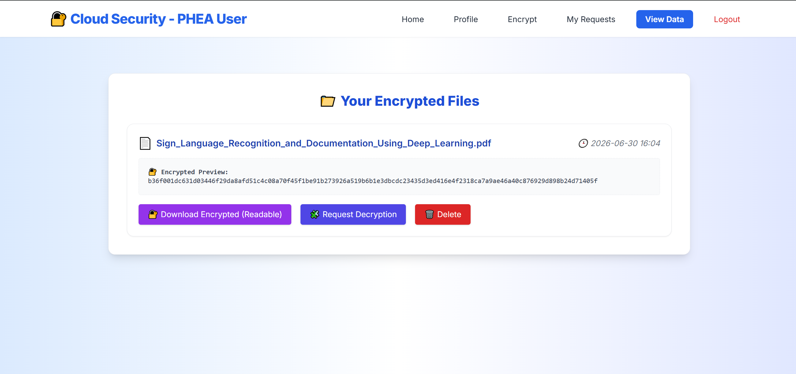
30 October 2026
Expected Input & Output
Input: User Registration & Key Verification
        New users input their credentials to create a secure account (Status: Pending).
        Verified users input their Paillier Private Key to unlock the file upload feature.
Output: Admin Approval Dashboard
  The Administrator dashboard displays a live queue of pending user decryption requests.
Output: Secure File Viewing
  The system successfully outputs a 60-byte Hexadecimal preview of the encrypted file to the user, ensuring the actual plaintext remains hidden.
Department of CS, Lords Institute of Engineering and Technology, (Autonomous), Hyderabad –Telangana -India

Slide 13
Conclusion
30 October 2026
This project successfully created a secure cloud storage website using both AES-128-CBC and Paillier Encryption.
It keeps files completely safe by making sure readable text is never saved in the database.
Strict rules—like checking secret keys and requiring admin approval to download files—stop hackers from getting in.
Testing proved the system is fast and practical, taking only 19 milliseconds to lock a file and 35 milliseconds to unlock it.
Department of CS, Lords Institute of Engineering and Technology, (Autonomous), Hyderabad –Telangana -India

Slide 14
30 October 2026
Thank You…
Department of CS, Lords Institute of Engineering and Technology, (Autonomous), Hyderabad –Telangana -India

Slide 15
References
30 October 2026
[1] M. E. Misri, “Enhancing Cloud Data Security Using Paillier Homomorphic Encryption Algorithm,” 2025 3rd International Conference on Integrated Circuits and Communication Systems (ICICACS), 2025.
[2] T. N. Kim and N. M. N. Pham, “Security-Performance Optimization in Cloud-Based Bank Data Processing Using HE-ZKP-ORAM,” Engineering, Technology & Applied Science Research, 2026.
[3] P. Paillier, “Public-Key Cryptosystems Based on Composite Degree Residuosity Classes,” in Advances in Cryptology—EUROCRYPT ’99, Springer, 1999.
[4] National Institute of Standards and Technology, Advanced Encryption Standard (AES), FIPS PUB 197-upd1, May 2023.
[5] M. A. Junior, P. Appiahene, O. Appiah, and K. Adu, “Cloud Data Privacy Protection with Homomorphic Algorithm: A Systematic Literature Review,” Journal of Cloud Computing, 2025.
.
Department of CS, Lords Institute of Engineering and Technology, (Autonomous), Hyderabad –Telangana -India

